Slide 1

HBaseConAsia2018
Gehua New Century Hotel Beijing，China
August 17,2018

Slide 2
HBase at DiDi
JingYi Yao

Slide 3
Content
01
HBase Improvements
& Applications
02
Phoenix Improvements
& Applications
03
GeoMesa Applications
04
Monitor & Operations

Slide 4
HBase Improvements
& Applications
01

Slide 5
HBase Improvements & Applications
1.HBase Applications at DiDi
2.ACL Improvements
3.Replication Improvements
4.Reduce User Connection

Slide 6
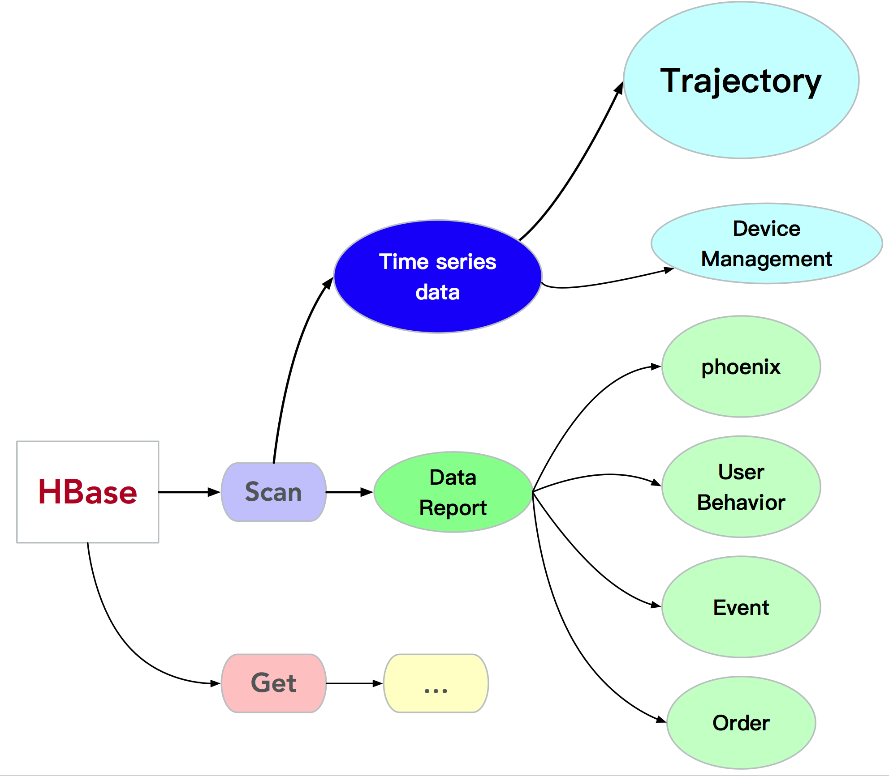
HBase Improvements & Applications
1.HBase Applications

Slide 7
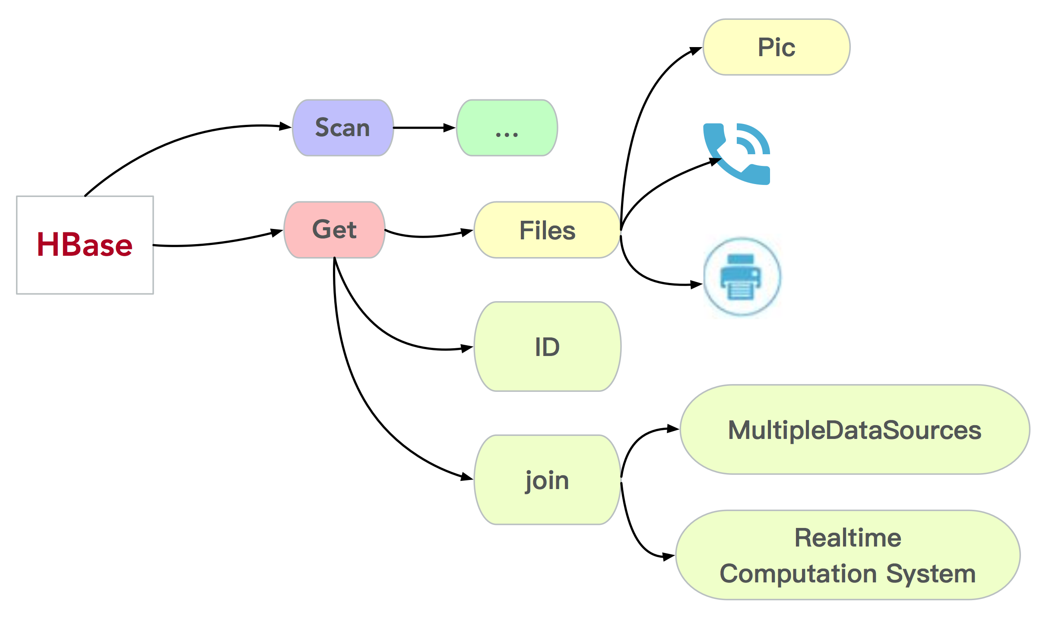
HBase Improvements & Applications
1.HBase Applications

Slide 8
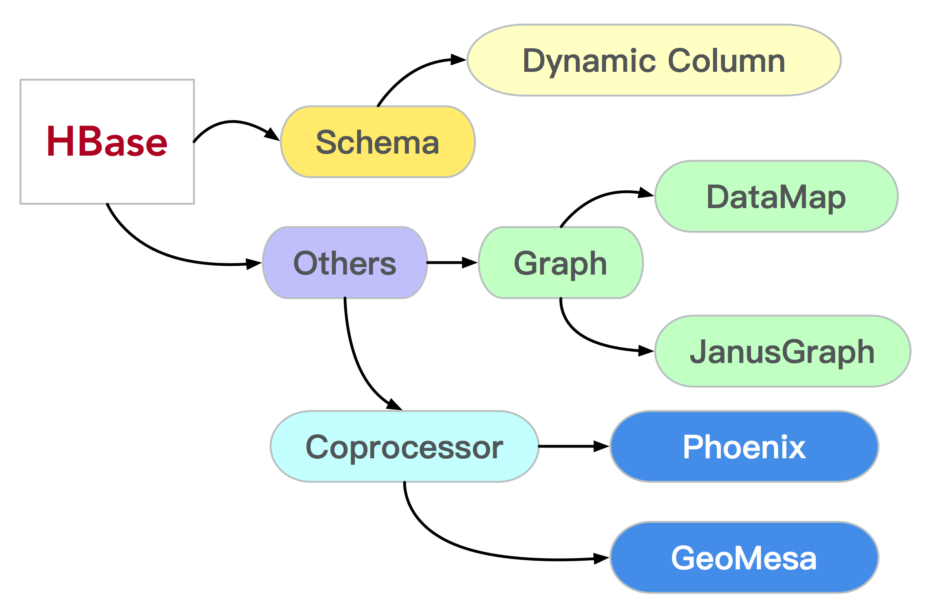
HBase Improvements & Applications
1.HBase Applications

Slide 9
HBase Improvements & Applications
1.HBase Applications
Message Queue
GeoGraphic Feature data
Heat Map
User Profile
Log Analysis

Slide 10
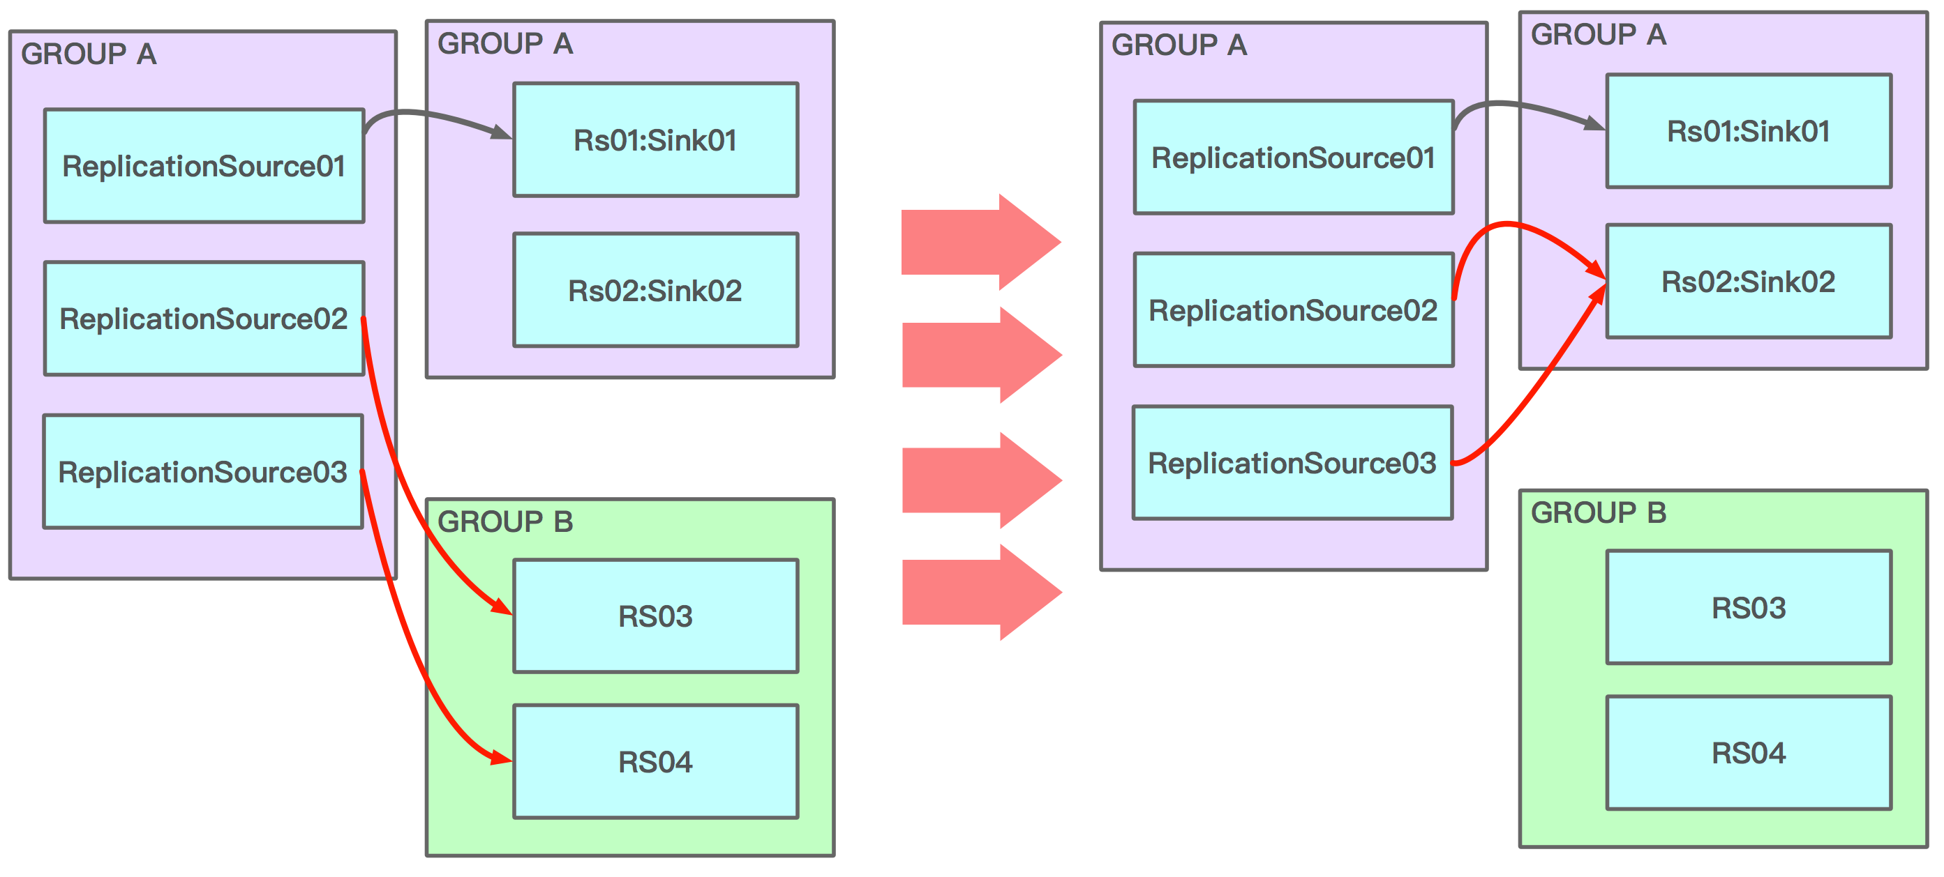
HBase Improvements & Applications
2.Replication Improvements

Slide 11
HBase Improvements & Applications
2.Replication Improvements
(1).Replication in RS Group
(2).Table Metric
(3).RS Group ratio

Slide 12
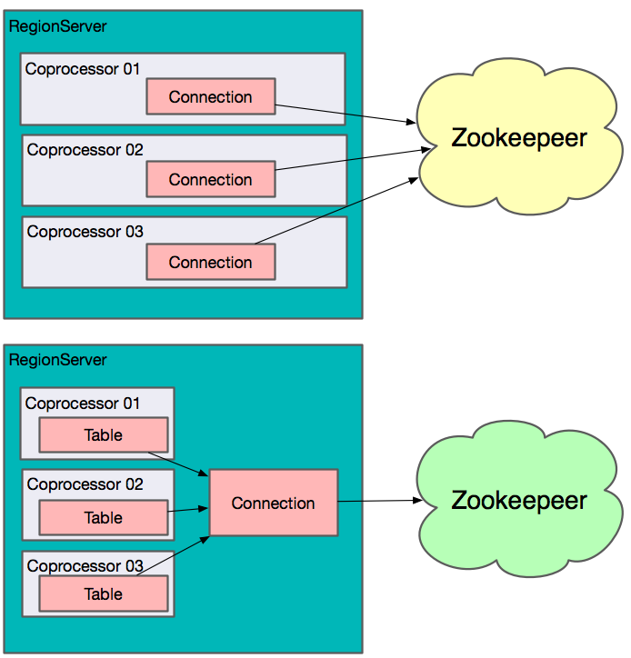
HBase Improvements & Applications
3.Connection
(1).users
(2).Coprocessor：
Regionserver clusterConnection

Slide 13
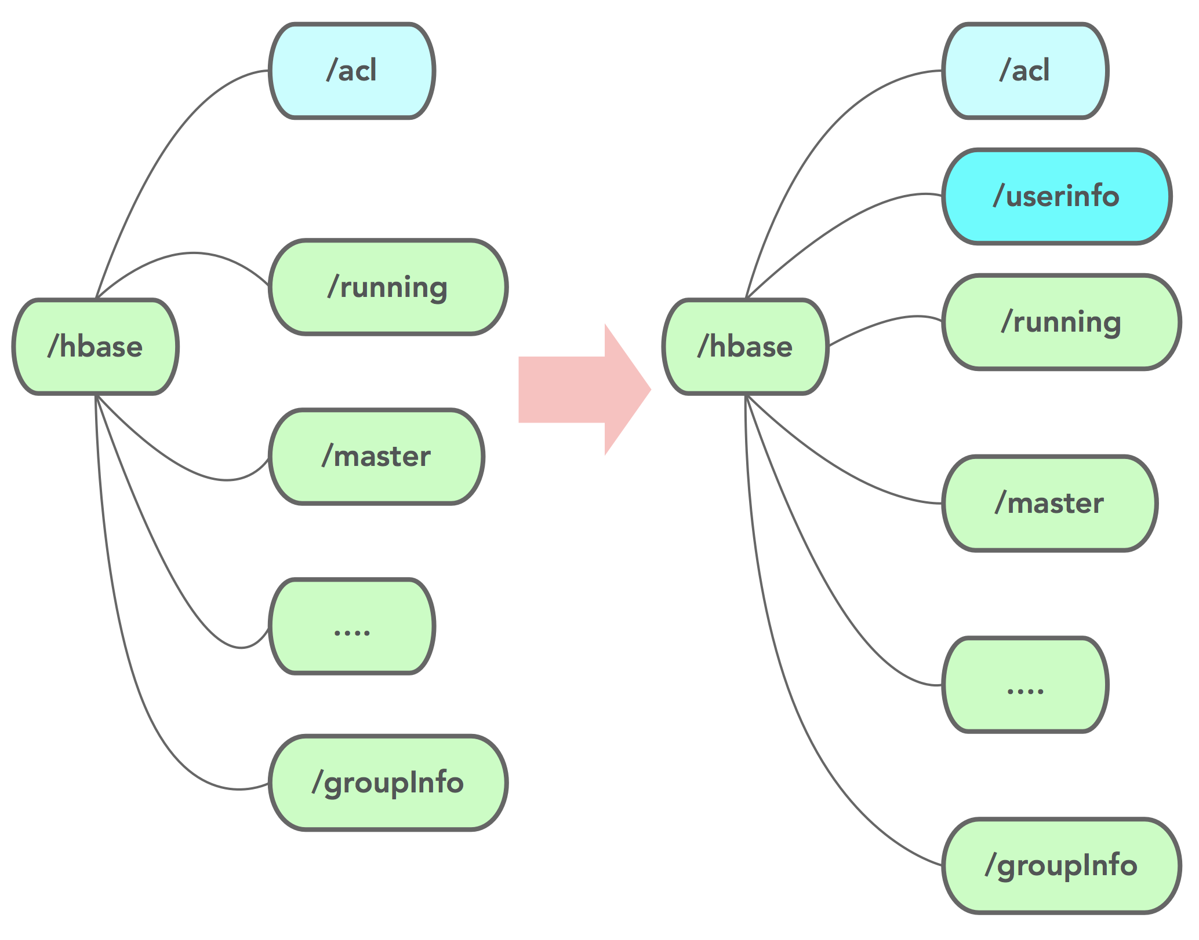
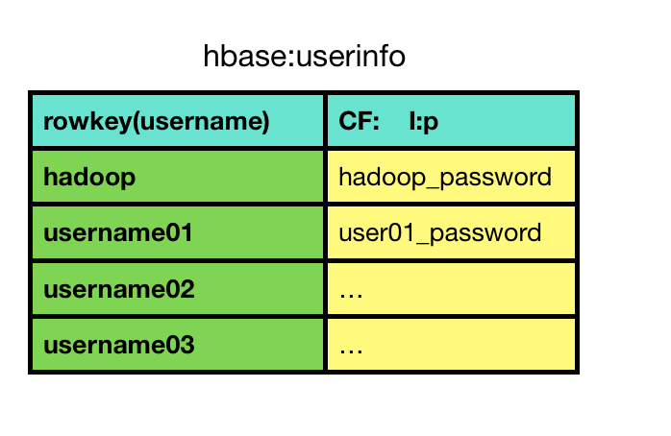
HBase Improvements & Applications
4.ACL Improvements

Slide 14
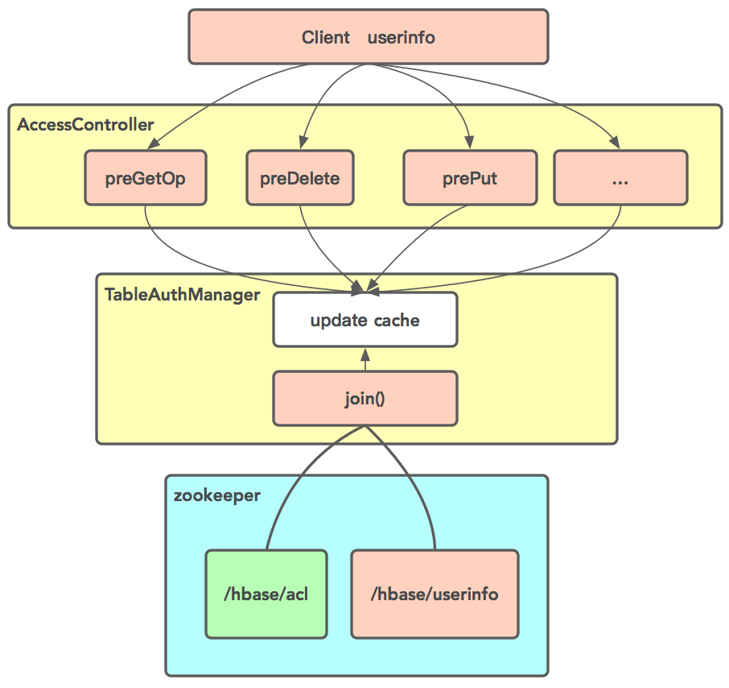
HBase Improvements & Applications
4.ACL Improvements

Slide 15
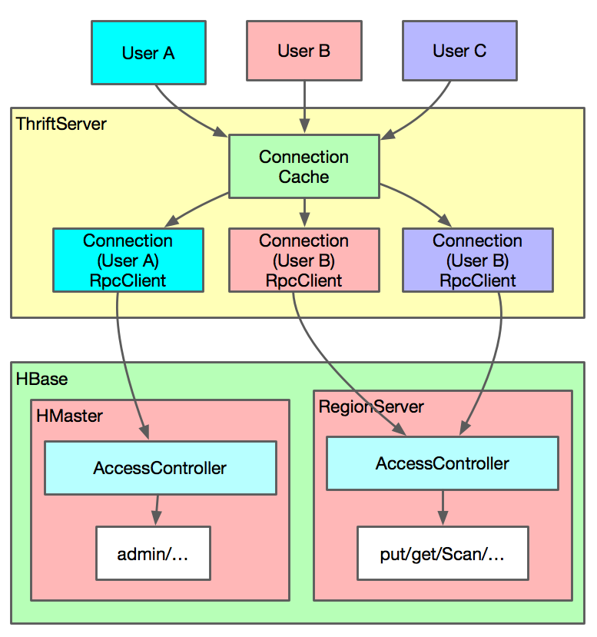
HBase Improvements & Applications
4.ACL Improvements

Slide 16
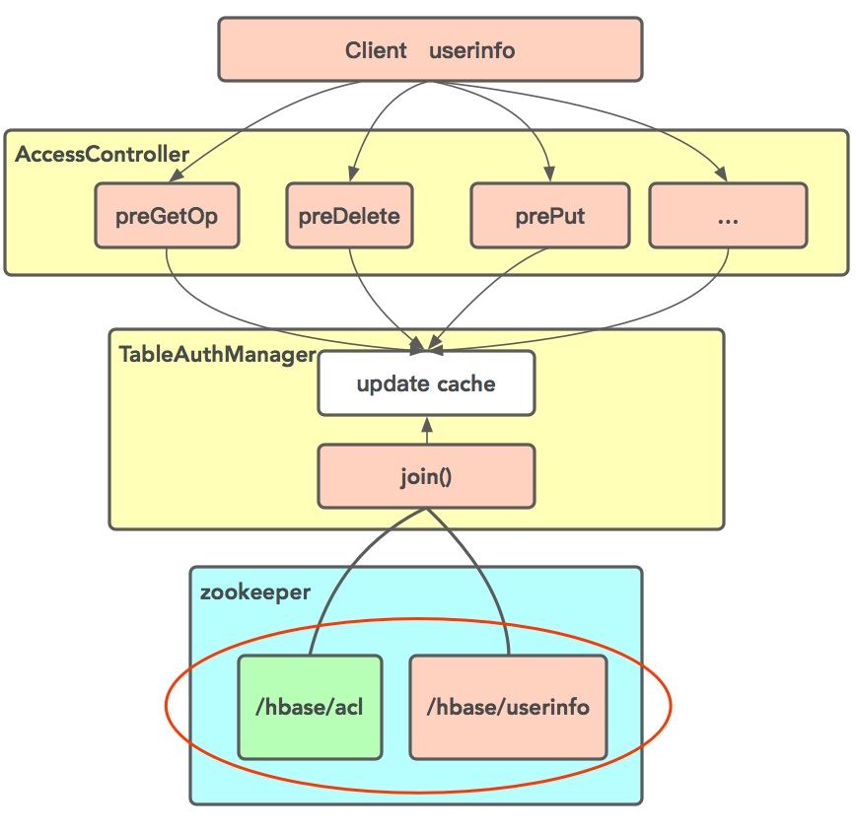
HBase Improvements & Applications
4.ACL Improvements
reduce zookeeper znode
and watcher

Slide 17
HBase Improvements & Applications
5.Others
(1)RPC audit log
(2)RSGroup bug fix
(3)quota
(4)safe drop table
…

Slide 18
Phoenix Improvements & Applications
02

Slide 19
Phoenix Improvements & Applications

Slide 20
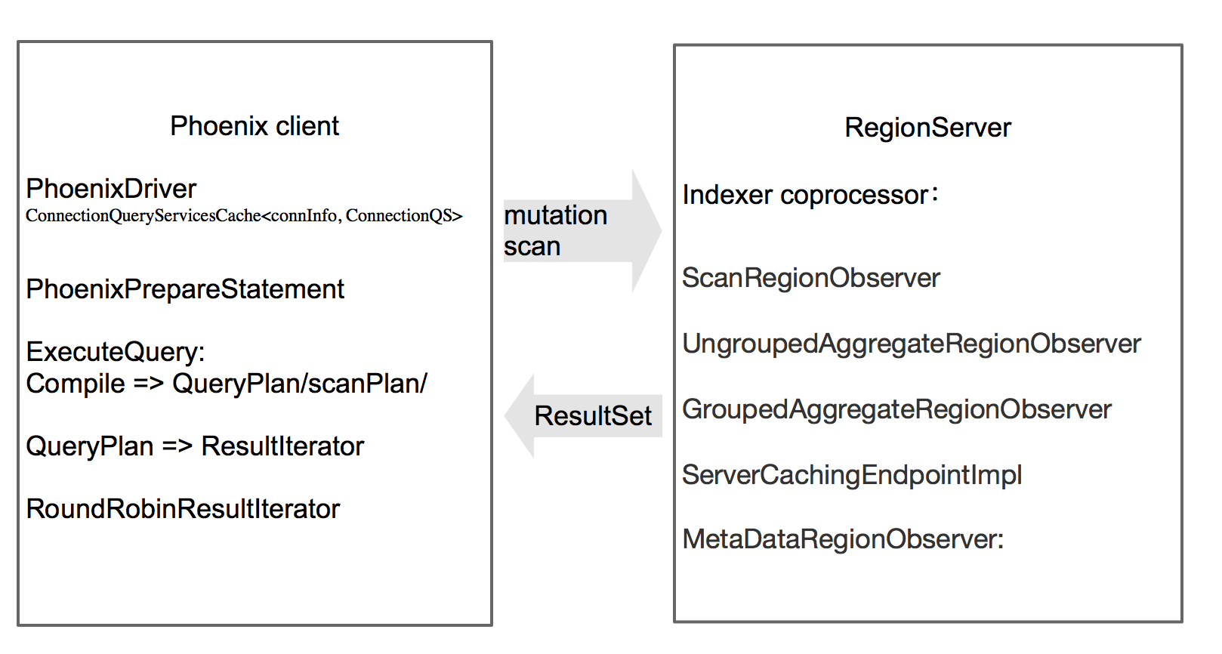
Phoenix Improvements & Applications

Slide 21
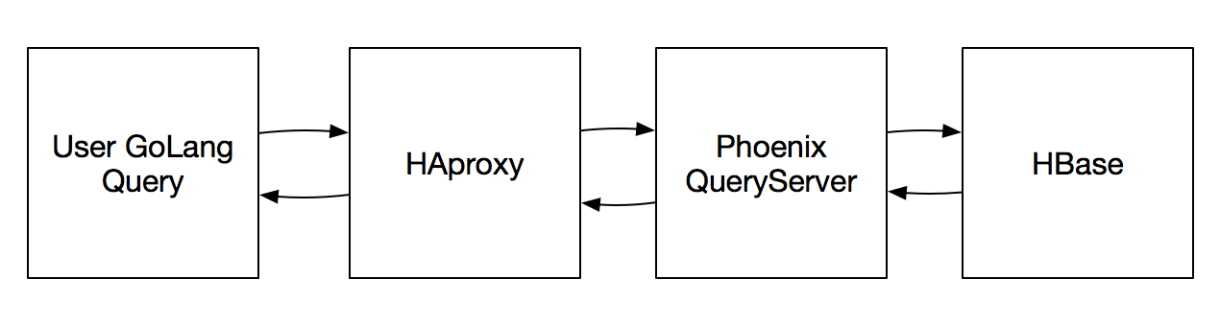
Phoenix Improvements & Applications
5.Order History
SLA 99.95%
Secondary indexes
Java-jdbc client P99 35 ms
column default
QueryServer

Slide 22
Phoenix Improvements & Applications
Secondary indexes ：
INDEX Type: Global Index => Covered Index
ASYNC INDEX
SALT_BUCKETS => reverse(ID) & pre split
coprocessor ：reduce connection
QueryServer metrics

Slide 23
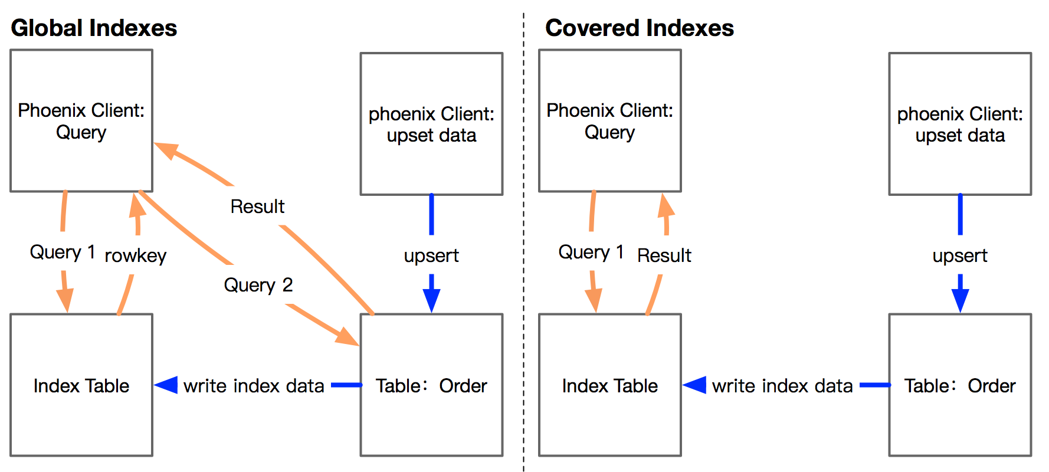
Phoenix Improvements & Applications

Slide 24
Phoenix Improvements & Applications
zk connection:
region num * Index num => 1

Slide 25
GeoMesa Applications
03

Slide 26
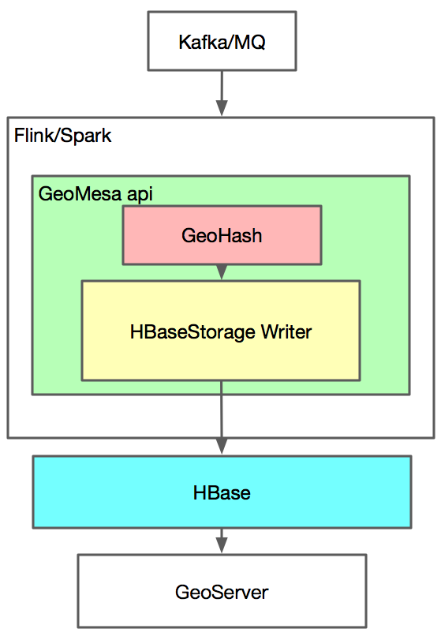
GeoMesa Applications
GeoMesa
GeoMesa is an open source suite of tools that enables large-scale geospatial querying and analytics on distributed computing systems.

Slide 27
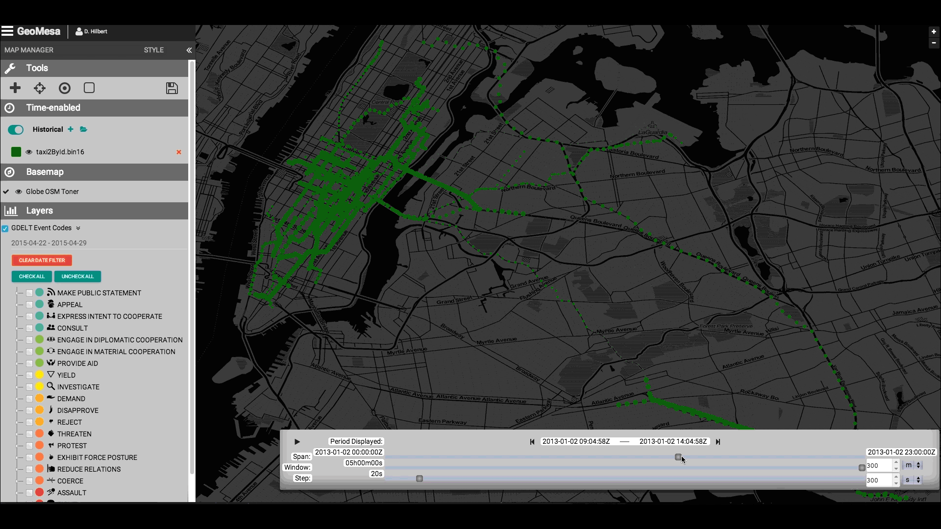
GeoMesa Applications
1.Road Detection
2.Device ID => Trajectory

Slide 28
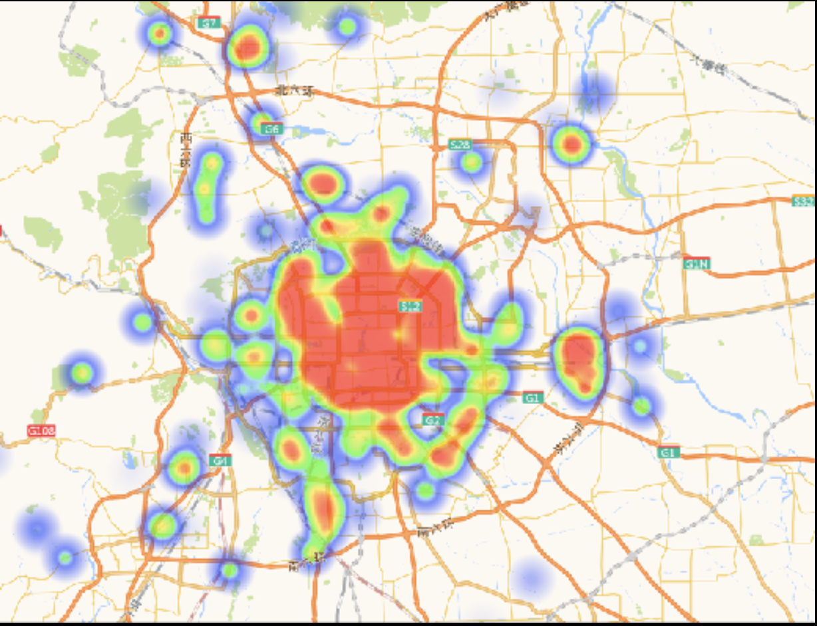
GeoMesa Applications

Slide 29
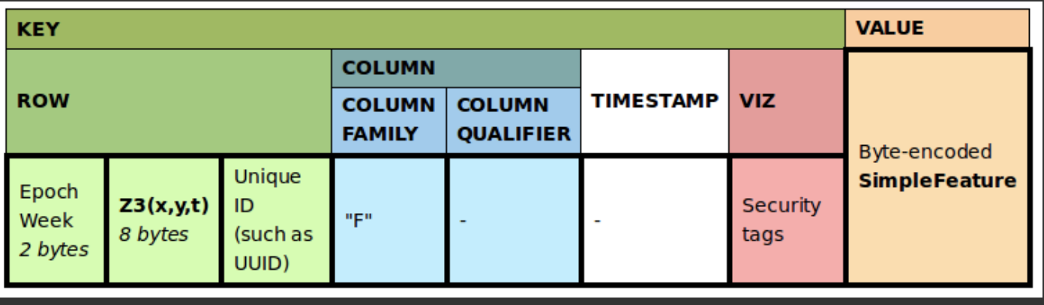
GeoMesa Applications
Index
Z2 : latitude and longitude
Z3 : latitude, longitude, and time
XZ2 : line strings or polygons
XZ3 : non-Point geometry and has a time attribute
Record/ID
Attribute

Slide 30
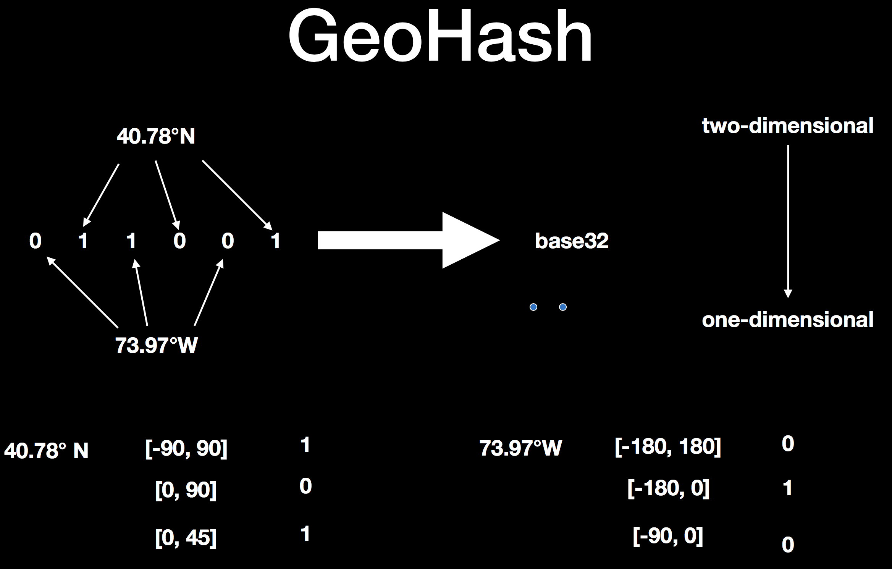
GeoMesa Applications
GeoHash:
geohashes have been used to first convert latitude and longitude into a single bit vector

Slide 31
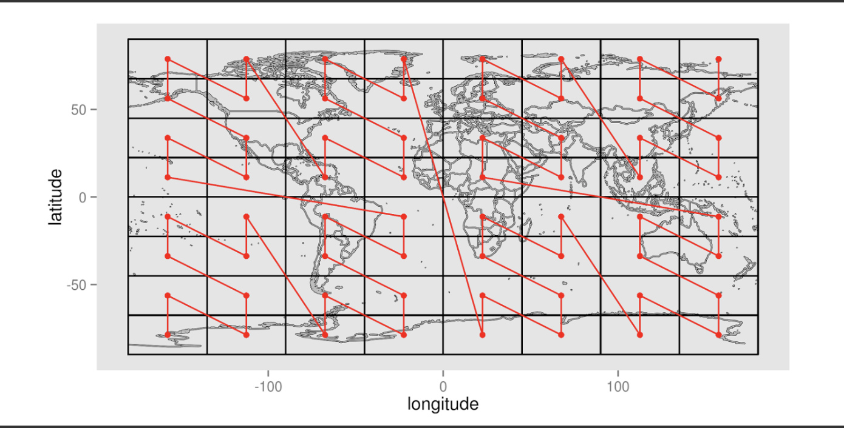
GeoMesa Applications
Z-order curve

Slide 32
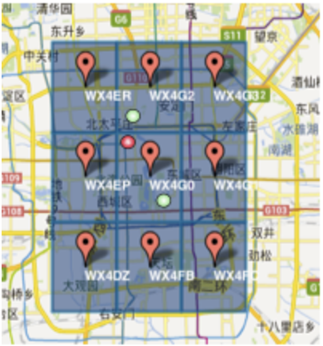
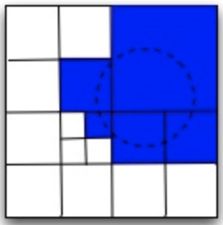
GeoMesa Applications
Z-order curve
Weakness
More scan

Slide 33
GeoMesa Applications
Future
Hilbert filling curve Inedx
Geomesa plan
Coprocessor
GeoMesa Stats
Experience from Phoenix

Slide 34
Monitor & Operations
04

Slide 35
Monitor & Operations
1.Monitor
(1).HBase
(2).Zookeeper
(3).HDFS
(4).ThriftServer
(5).Queryserver

Slide 36
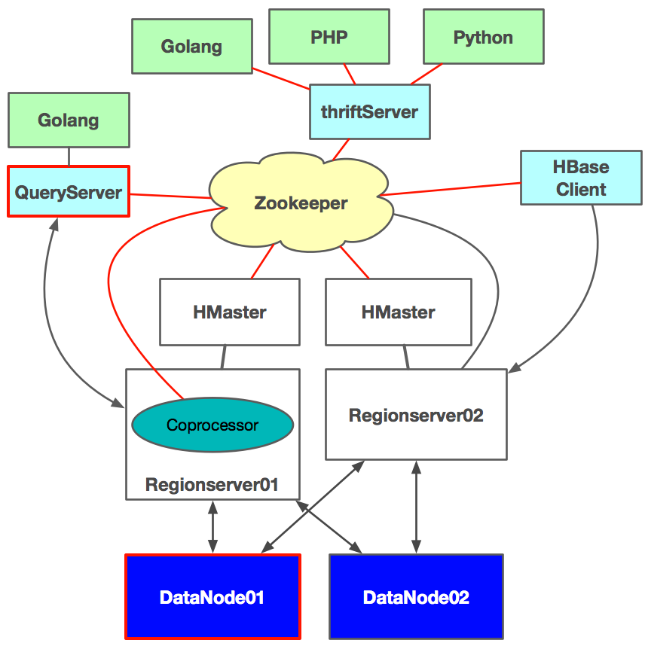
Monitor & Operations
Zookeeper

Slide 37
Monitor & Operations
echo mntr | nc $zookeeper 2181
zk_num_alive_connections
zk_open_file_descriptor_count
zk_outstanding_requests
zk_min_latency
zk_followers

Slide 38
Monitor & Operations
ThriftServer
[Put | Get | Scan …]_99th_percentile
Slow Read/Write …
QueryServer
print slow prepareStatement
print slow query
ExecuteQueryTime_99th_percentile

Slide 39
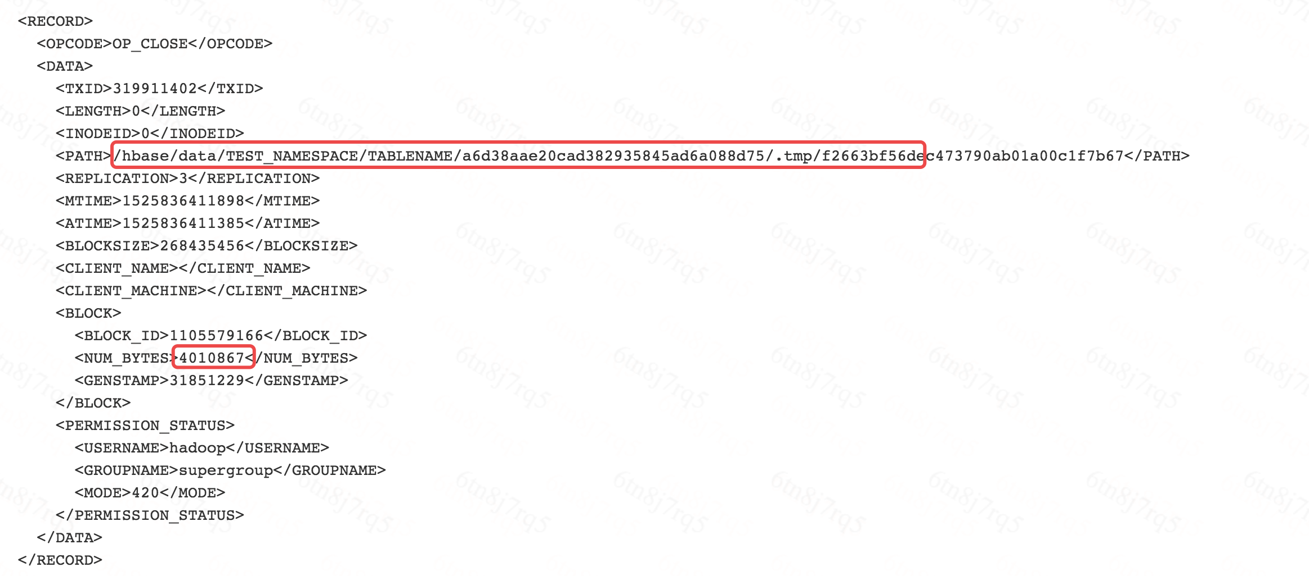
Monitor & Operations
HDFS
slow disk
edits log => hdfs path

Slide 40
Monitor & Operations
DHS(Didi HBase Service)：
Visualizing Information: Region hot-spots from Region Metric
Read、Write、StoreSize

Slide 41
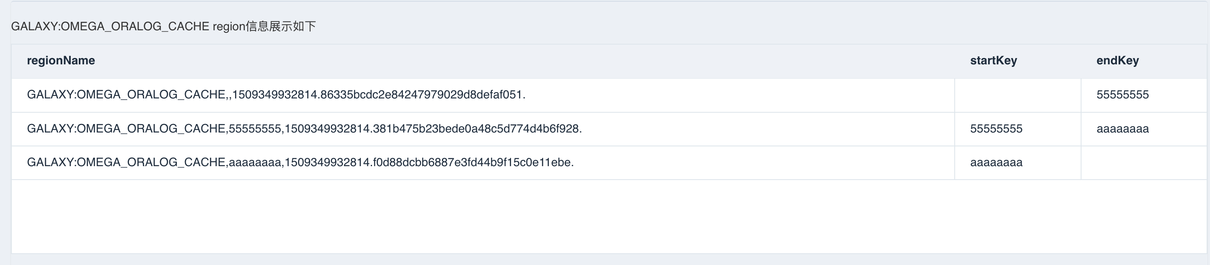
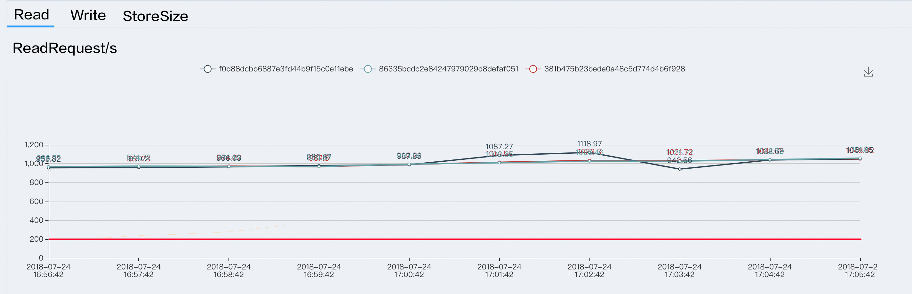
Monitor & Operations
The highest 10
&
The lowest 10

Slide 42
Monitor & Operations
Automatic computation：input/Output Size per sec.Store Size..
Recommended values：Region Count

Slide 43
Monitor & Operations
HBase Metric
(1).read request、write request、Mutate_99th_percentile、Get_99th_percentile、ScanTime_99th_percentile、receivedBytes、sentBytes
(2).compactionQueueLength、flushQueueLength、splitQueueLength
(3).jvm metrics…
slow request: Rpc p99、gc、compaction queue 、slow log

Slide 44
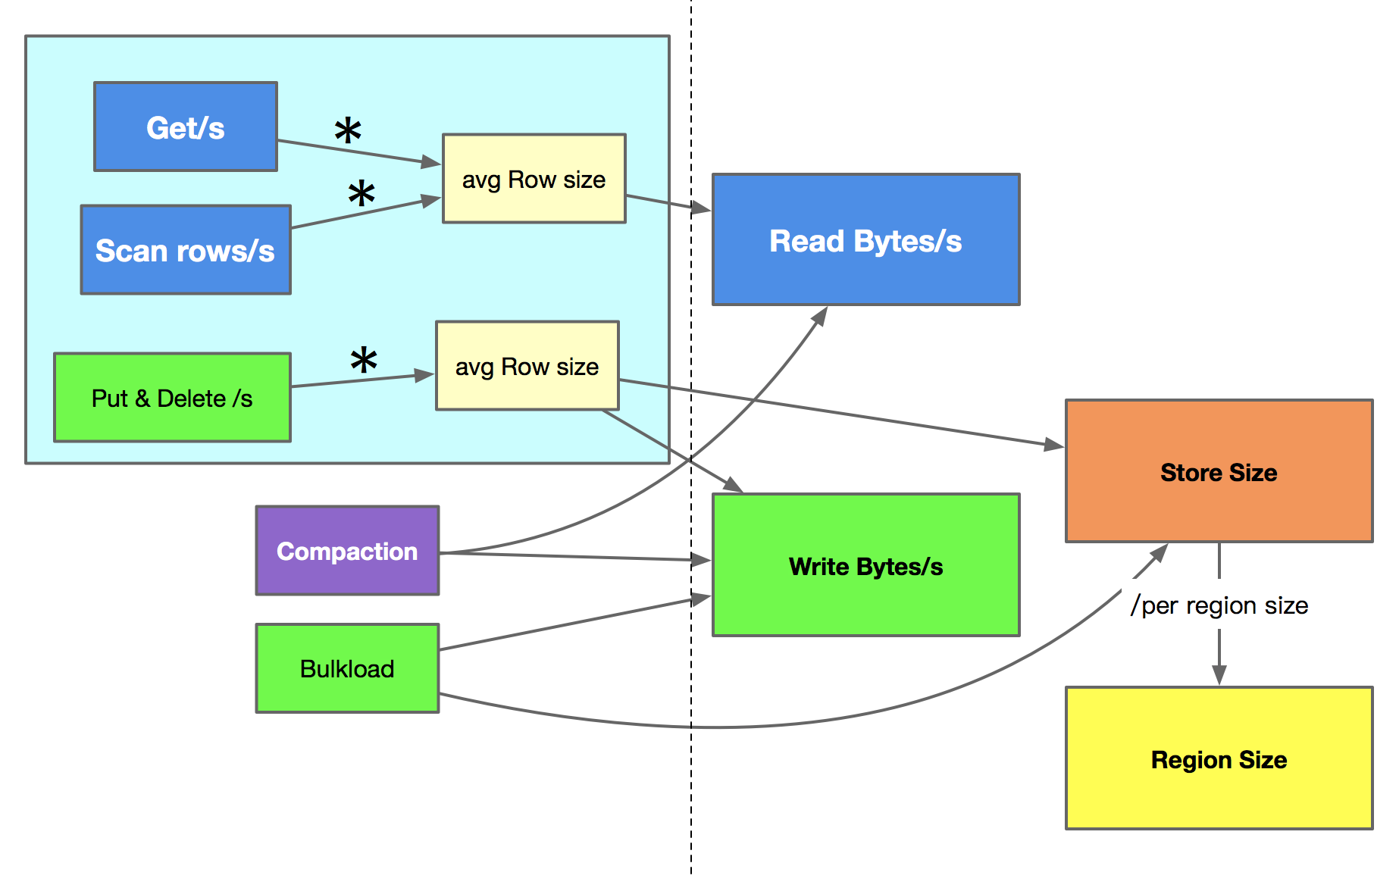
Monitor & Operations

Slide 45
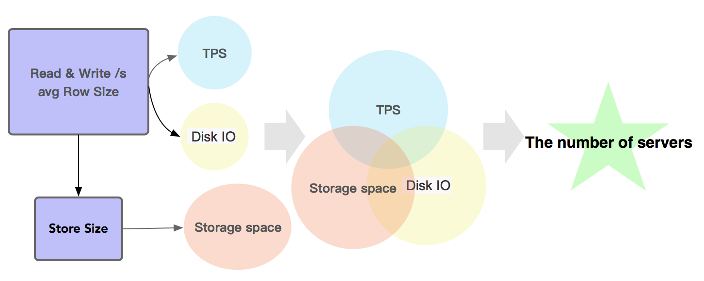
Monitor & Operations

Slide 46

Monitor & Operations
yaojingyi@didichuxing.com

Slide 47
Thanks

